Slide 1
shinyMixR essentials

Slide 2
shinyMixR: Shiny dashboard interface for nlmixr
shinyMixR 0.4.0
The shinyMixR package is initially developed as a graphical interface for the nlmixr package and provides full support for nlmixr2. The package include a shiny (dashboard) interface and helps in managing, running, editing and analysing nlmixr models. Although the main focus was to build an interface, many of the package functions are also directly available for usage in an interactive R session.
More details are available on :
https://richardhooijmaijers.github.io/shinyMixR/index.html

Slide 3
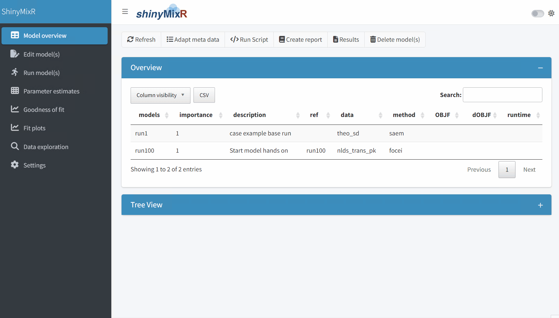
Run model

Slide 4

Data Exploration Essentials
Optional

Slide 5
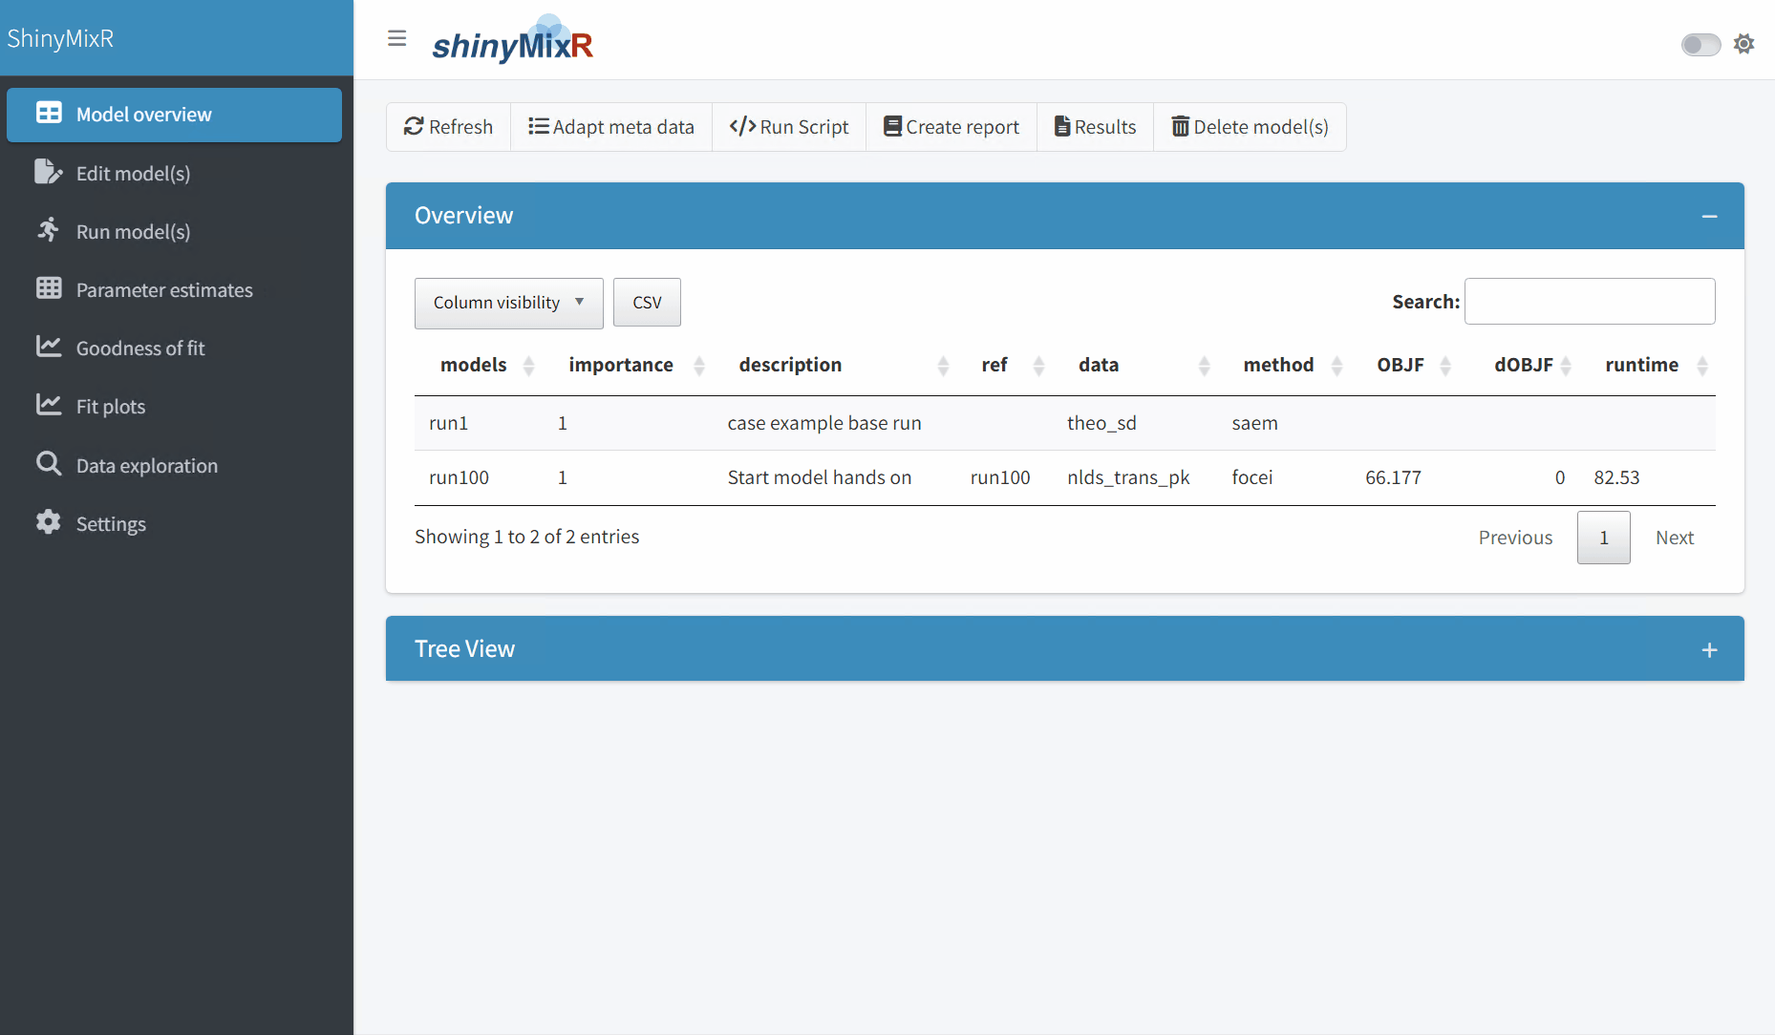
Edit model

Slide 6
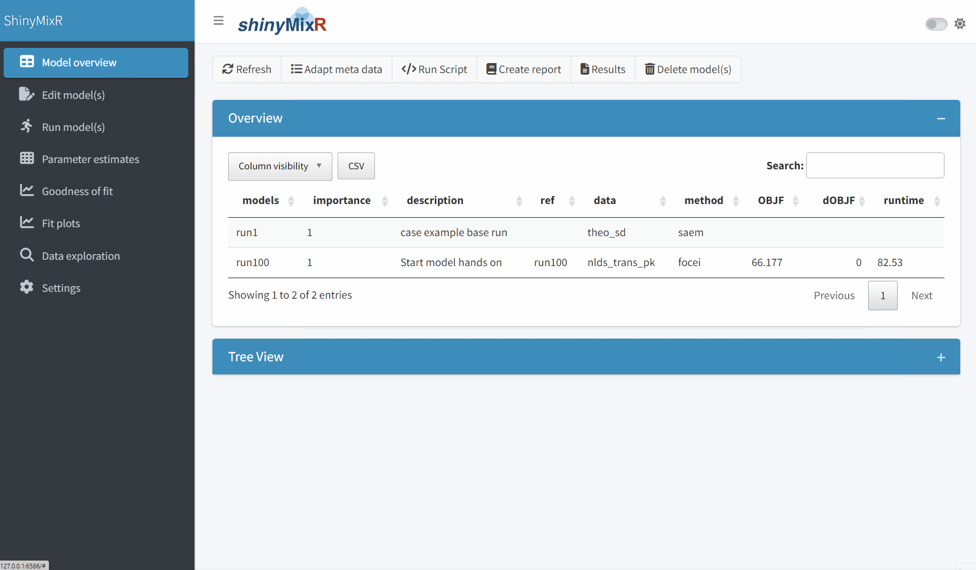
Parameter table

Slide 7
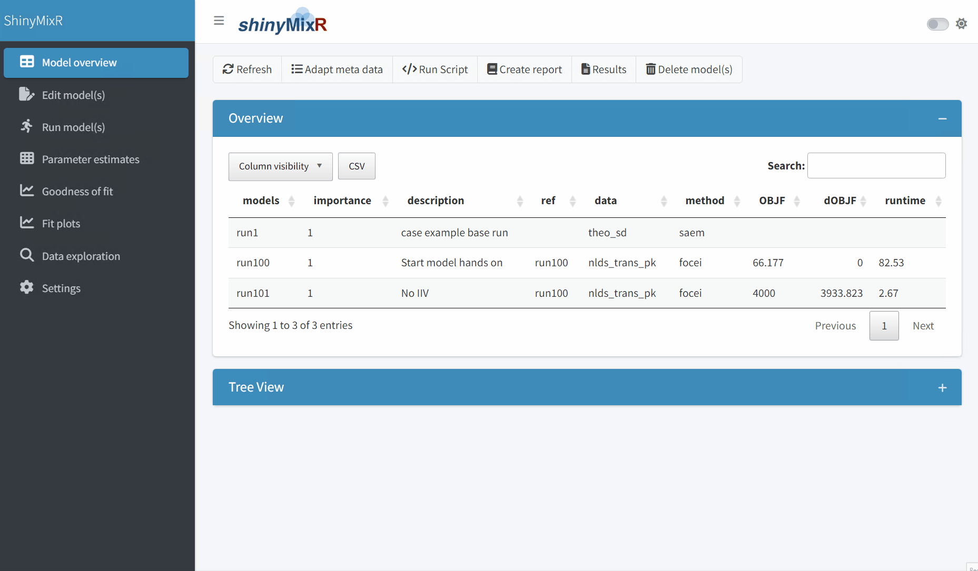
Fit evaluation

Slide 8
Dataset information

Slide 9
Explanation starting dataset
PK - SD
nlds_trans_sd_pk.csv
RECN Unique record number (e.g. useful to ignore an outlying data record)
ID Animal ID number
TIME Time in hours
CMT Compartment
EVID Dosing event: 1 = Dose, 0 = Not a dose
AMT Amount dose in mg
DV Ordinary untransformed dependent variable in mg/L
LNDV Log transformed version of ODV
FLAG Identifier
DGRP Dose group in mg/kg
ROUTE Administration route: 1 = intravenous (iv), 2 = subcutanous (sc) for mAb, oral for small molecule
BW Baseline body weight in kg
ADA Flag to identify observations at the presence of anti-drug antibodies
SPEC Species: 2 = monkey, 3 = rat, 4 = mouse
CMPD Compound: 1 = mAb , 2 = small molecule
For your convenience: BQL data removed
(Impact) ignored in current course

Slide 10
Explanation starting dataset
PK - MD
nlds_trans_md_pk.csv
RECN Unique record number (e.g. useful to ignore an outlying data record)
ID Animal ID number
TIME Time in hours
CMT Compartment
EVID Dosing event: 1 = Dose, 0 = Not a dose
AMT Amount dose in mg
DV Ordinary untransformed dependent variable in mg/L
LNDV Log transformed version of ODV
FLAG Identifier
DGRP Dose group in mg/kg
II Interdose Interval
ADDL Number of additional identical doses
ROUTE Administration route: 1 = intravenous (iv), 2 = subcutanous (sc)
BW Baseline body weight in kg
ADA Flag to identify observations at the presence of anti-drug antibodies
SPEC Species: 2 = monkey, 3 = rat, 4 = mouse
CMPD Compound: 1 = mAb , 2 = small molecule
For your convenience: BQL data removed
(Impact) ignored in current course

Slide 11
Explanation starting dataset
PD
nlds_trans_pkpd.csv
ID Animal ID number
TIME Time in hours
EVID Dosing event: 1 = Dose, 0 = Not a dose
AMT Amount dose in mg
ROUTE Administration route: 1 = intravenous (iv), 2 = subcutanous (sc)
CMT
DVID DV identifier: 1 = Concentration , 2 = PD marker
ODV Ordinary untransformed dependent variable in mg/L
DV Log transformed version of ODV
DGRP Dose group in mg/kg
BW Baseline body weight in kg
SPEC Species: 1 = human
RECN Unique record number (e.g. useful to ignore an outlying data record)
For your convenience: BQL data removed
(Impact) ignored in current course
No unit transformation in models, Therefore, parameter units:
Volumes in L
Flows in L/d
Rate constants in 1/d
Concentrations in nM
Production rate in nM/d

Slide 12
Coding examples

Slide 13
Explanation starting model (1/2)
run001 <- function() {
data = "nlds_trans_pk"
subs = "SPEC==1"
desc = "User specific model description"
ref = "run100"
imp = 1
est = "focei"
control = list()
ini({
TVCL <- c(0,0.01)
TVV1 <- fix(0.1)
ETA.CL ~ fix(0)
ETA.V1 ~ 0.1
ADD.ERR.PK <- 0.1
})
Note: don’t change format
runXXX needs to be aligned with r file name
data: dataset
subs: subset, r syntax, SPEC==1 equals monkeys
ref: reference run (not required; user choice)
imp: importance (not required; user choice)
est: estimation method
TVCL <- c(0,0.01): boundary 0, initial 0.01
TVV1 <- fix(0.1) : fixed to 0.1
ETA.CL ~ fix(0): IIV fixed
ETA.V1 ~ 0.1 : IIV estimated
Note: these are variances
ADD.ERR.PK <- 0.1 : Residual error estimated
Note: this is a standard deviation, not a variance
For you own projects consider naming: ADD.SD.PK
Meta data
User selected initials
NM compare:
$THETA
$OMEGA
$SIGMA

Slide 14
Explanation starting model (2/2)
Note: don’t change format
model({
CL <- TVCL * exp(ETA.CL)
V1 <- TVV1 * exp(ETA.V1)
KEL <- CL/V1
d/dt(A1) = - KEL*A1
C1 = A1/V1
CP = log(C1)
CP ~ add(ADD.ERR.PK)
# For output
SPEC.OUT <- SPEC
DGRP.OUT <- DGRP
BW.OUT <- BW
})
}
Dataset: DVID==‘CP’ → Log transformed PK concentrations
Key variables for postprocessing from input to output
Note: BW.OUT not strictly necessary as BW used in this model, but not necessarily in all models
Model
NM compare:
$PK
$DES
$ERROR
$TABLE

Slide 15
Nlmixr2: additional features handy for this course
NONMEM MAXEVAL=0 equivalent: replace “focei” with “posthoc”
Fixing parameters: TVCL <- fix(0.1)
If statements
CL <- TVCL if (SPEC == 2) {CL <- TVCL2}
if (SPEC == 1) {CL <- TVCL} else if (SPEC == 2) {CL <- TVCL2}
Power: ^
Block: eta.cl + eta.v ~ c(1, 0.01, 1)
Structural model: all ind. random effects fix(0) possible but sometimes unstable (personal experience)
If unstable circumvent via ETA.CL ~ fix(1e-13)
Initial estimates (like NONMEM): c(1) = no boundaries; c(0,1) = 0 lower boundary; c(0,1,10) = estimation between 0 and 10
Dataset requirements via: https://nlmixr2.github.io/rxode2/articles/rxode2-event-types.html

Slide 16
Nlmixr2: choices made for this course
We will estimate with “focei” (other estimation possible; but focei more straightforward, e.g. saem less stable when not mu referenced)
We will use shinymixr, alternatively, a workflow in r is possible, e.g:
Fitting in r: fit <- nlmixr2(nlmixrFun, nlmixrData, est=“focei"); where nlmixrFun contains ini and model block from code in shinymixr
We focus on additive residual error (of log transformed PK)
Note multiple error possible, but not needed for this course: CP ~ prop(eps.pkprop) + add(eps.pkadd)

